Slide 1


Slide 2

Flood Frequency Analysis for Kabul River Basin under Climate Change using Machine Learning Algorithms.
Final Defense Presentation

Slide 3
Supervisor: Dr. Tabinda Masud
Group Members:
Umer Sher Khan (21PWCIV5741)
Mohsin Ahmad (21PWCIV5661)
Muhammad Tayyab Jan (21PWCIV5636)
Muhammad Abbas Khan (21PWCIV5758)

Slide 4
Background:
The Kabul River originates from the mountains of Hindu Kush and covers about 700km distance before joining the Pakistan water system [1].
This study aims to analyze future changes in flood frequency and intensity in the Kabul river basin to prepare for natural flood hazards and prevent financial losses
The Kabul River is facing a significant threat due to changing climatic conditions, which are affecting its water availability.
In 2010, floods in the Indus river basin resulted in 5.4 million acres of land lost, 2200 deaths, and 14 million homeless, resulting in 43 billion USD. Additionally, changes in river water levels can negatively impact Pakistan's agriculture sector, which contributed to the country's GDP in 2020.

Slide 5
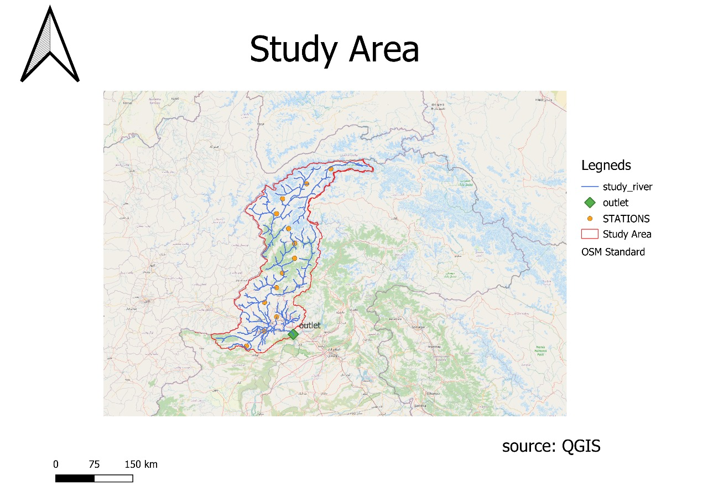
Study Area:
ORIGIN:
Approximate coordinates: 34.5165° N, 70.3350° E (near the Hindu Kush).
CONFLUENCE WITH INDUS RIVER:
Approximate coordinates near Attock, Pakistan: 33.7432° N, 72.3657° E.
DISCHARGE:
Average discharge varies seasonally, typically around 300m³/s
CATCHMENT AREA:
The Kabul River has a catchment area of approximately 67,500 km².

Slide 6
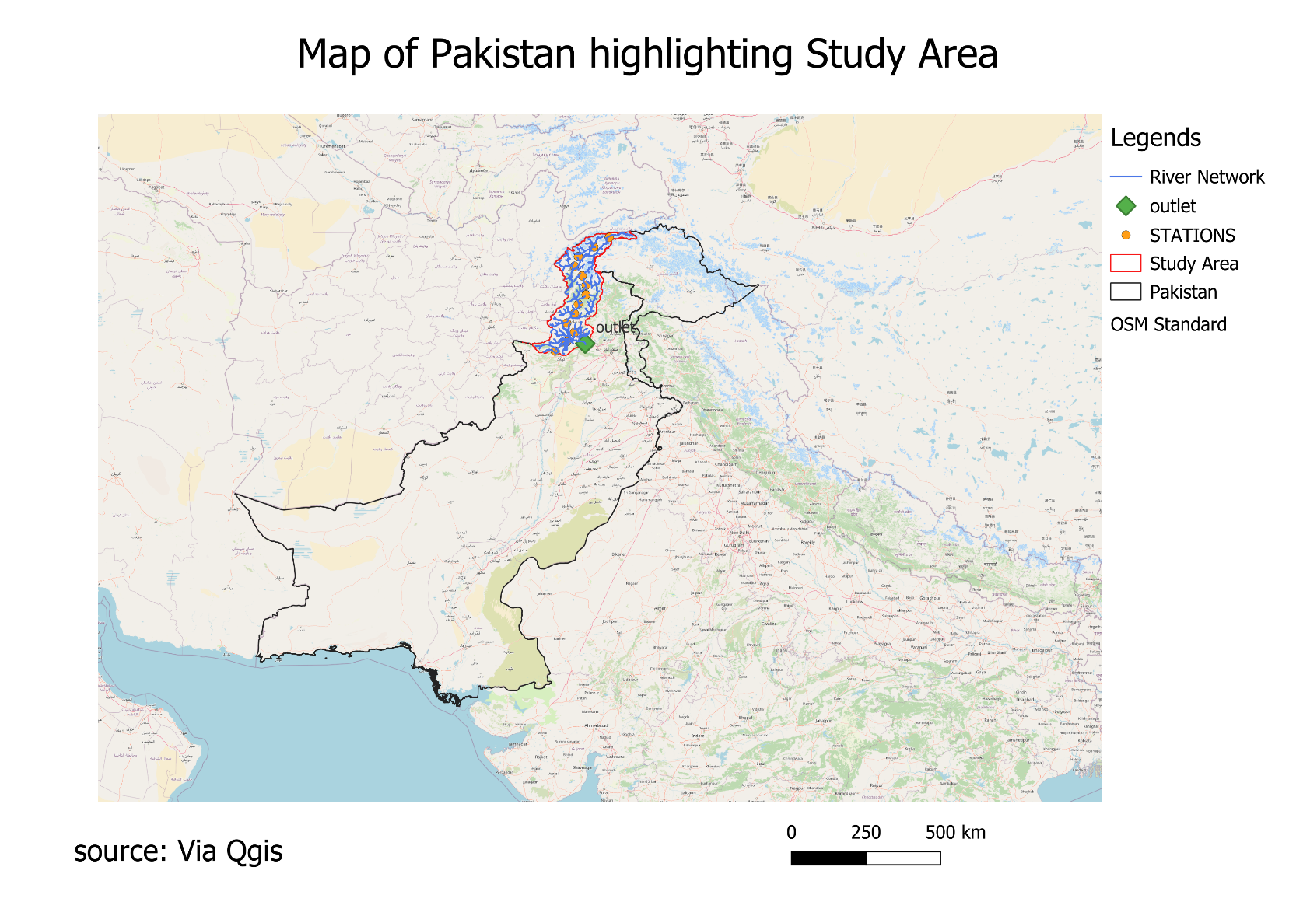
Afghanistan: Around 52,000 km²
Pakistan: Around 15,500 km²
Peak flow usually occurs during spring and summer due to snowmelt in the Hindu Kush mountains.

Slide 7
Problem Statement:
The unpredictability of extreme flood events poses a significant challenge to water resource management in the Kabul River Basin (KRB), crucial for irrigation and flood control in northern Pakistan. The severity of this issue was evident in the 2010 and 2022 floods, where inadequate flood forecasting and management led to widespread devastation across Khyber Pakhtunkhwa (KP) and downstream regions. The basin, prone to extreme climate variability, requires accurate flood frequency analysis to improve flood mitigation strategies. this study aims to develop a data-driven flood forecasting model using LSTM, CNN, Hybrid LSTM-CNN, ensuring improved flood assessment and decision-making for the sustainable management of the KRB.

Slide 8
Study Objective:
This study aims to conduct a comprehensive flood frequency analysis to identify patterns and probabilities of flooding, providing critical insights for policymakers and disaster management agencies.

Slide 9
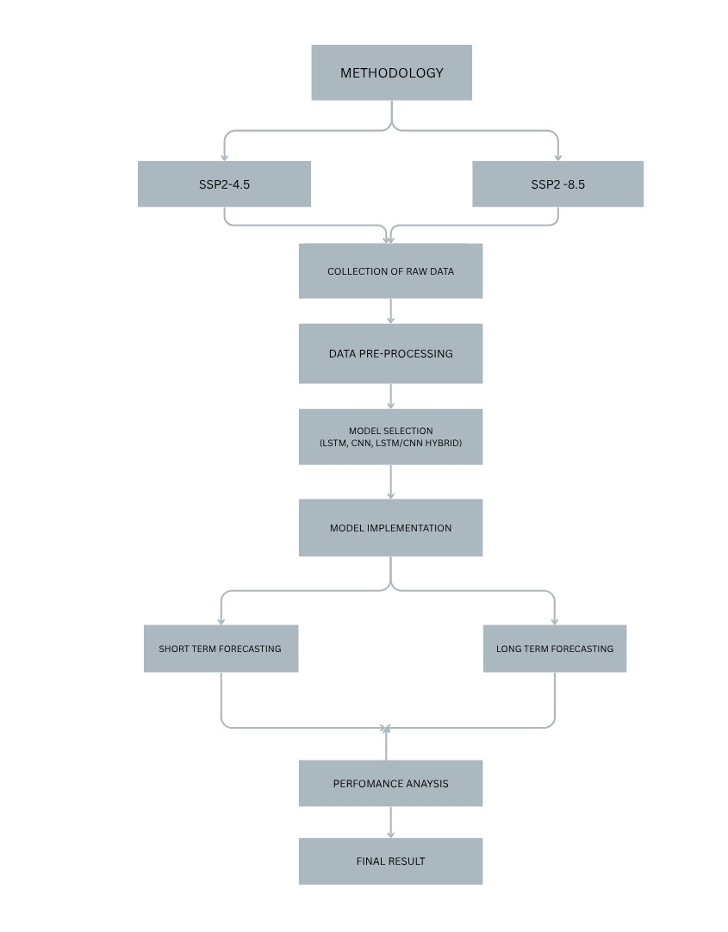
Methodology:

Slide 10
Model implemention:
Splitting Data into training and testing phases for both scenarios i.e. SSP2-4.5 & SSP5-8.5 .
Different combinations of test train split were Tested.
The Best combination was selected
Implemented LSTM, CNN, and LSTM-CNN models from Python libraries.

Slide 11
Normal Case Scenario SSP2-4.5:

Slide 12
SSP2-4.5:
The Three selected models were implemented on SSP2-4.5 scenario.
The models were evaluated for train and test.
The results of each model are given in the proceeding slides

Slide 13
Training Phase:

Slide 14
Model Name | R-squared | Observed RMSE(cumecs)
LSTM | 0.93 | 142
CNN | 0.86 | 330
LSTM-CNN | 0.95 | 285

Slide 15
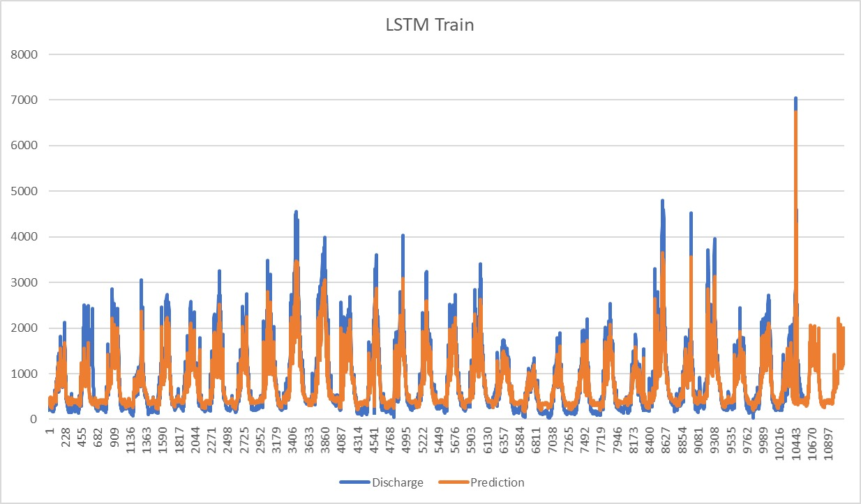
LSTM Train:

Slide 16
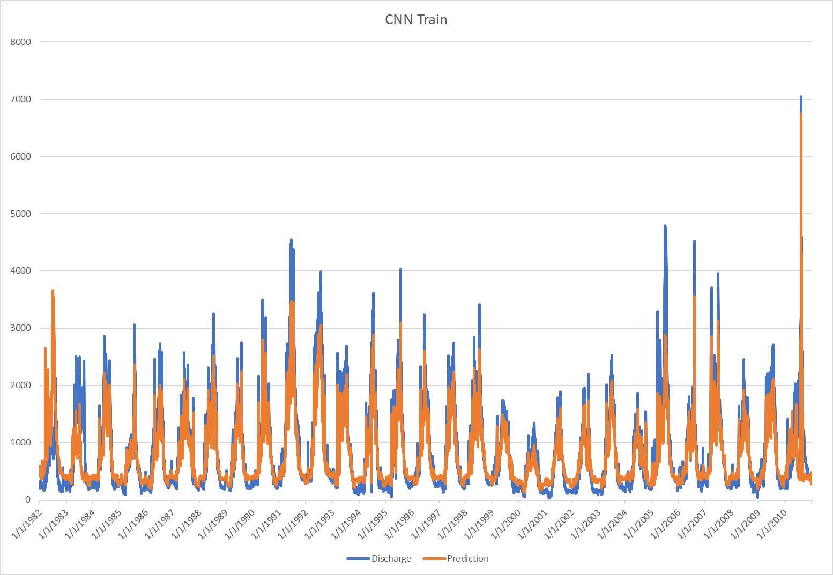
CNN Train:

Slide 17
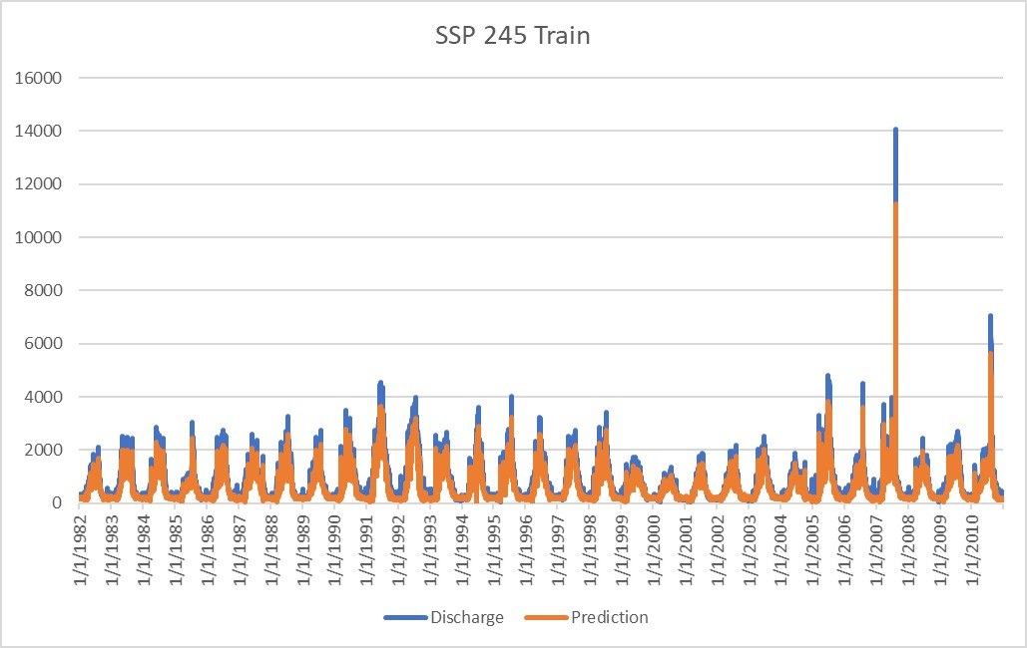
LSTM-CNN Train:

Slide 18
Model Performance Indicators(Test Results):

Slide 19
Model Name | R-squared | Observed RMSE(cumecs)
LSTM | 0.86 | 240
CNN | 0.882 | 285.6
LSTM-CNN | 0.897 | 344.7

Slide 20
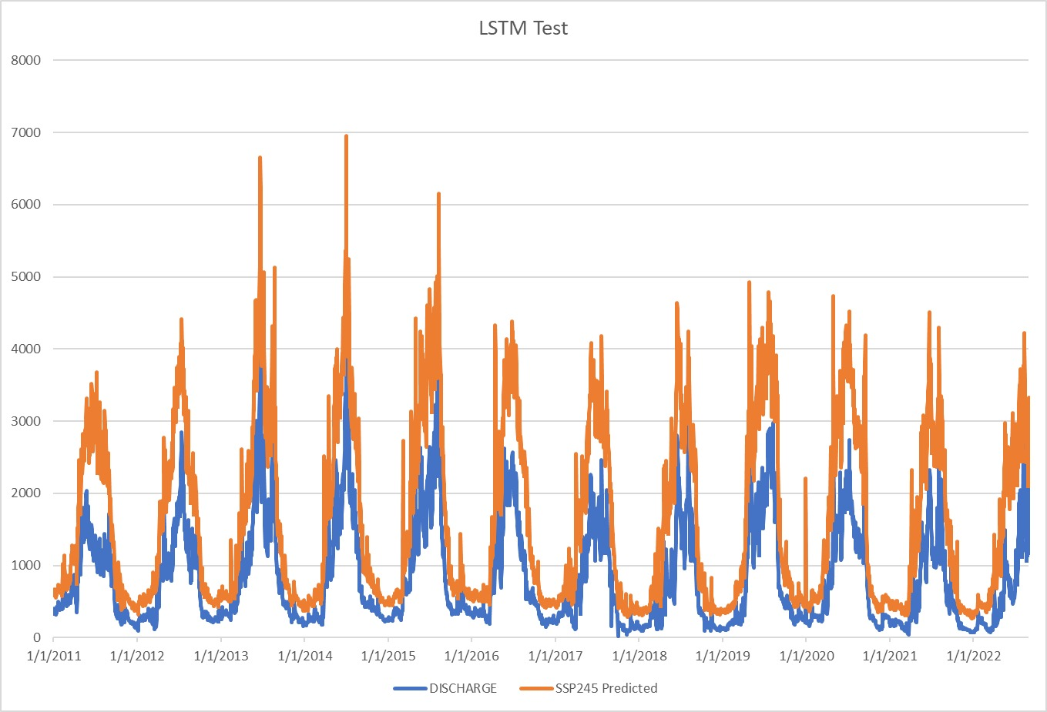
LSTM Test:

Slide 21
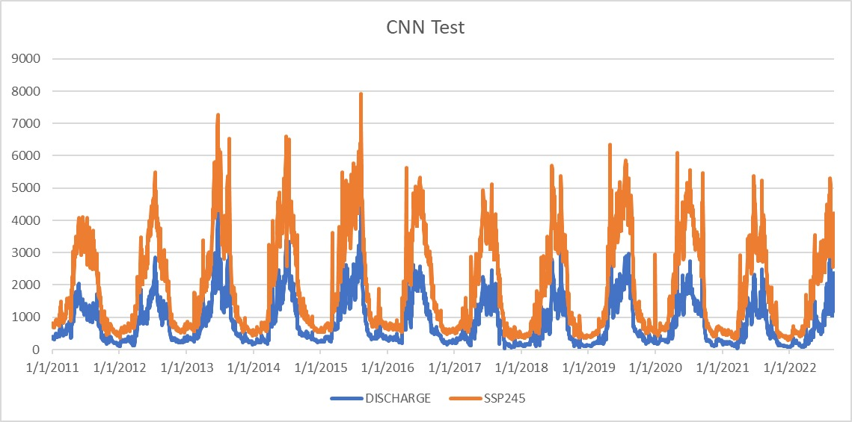
CNN Test:

Slide 22
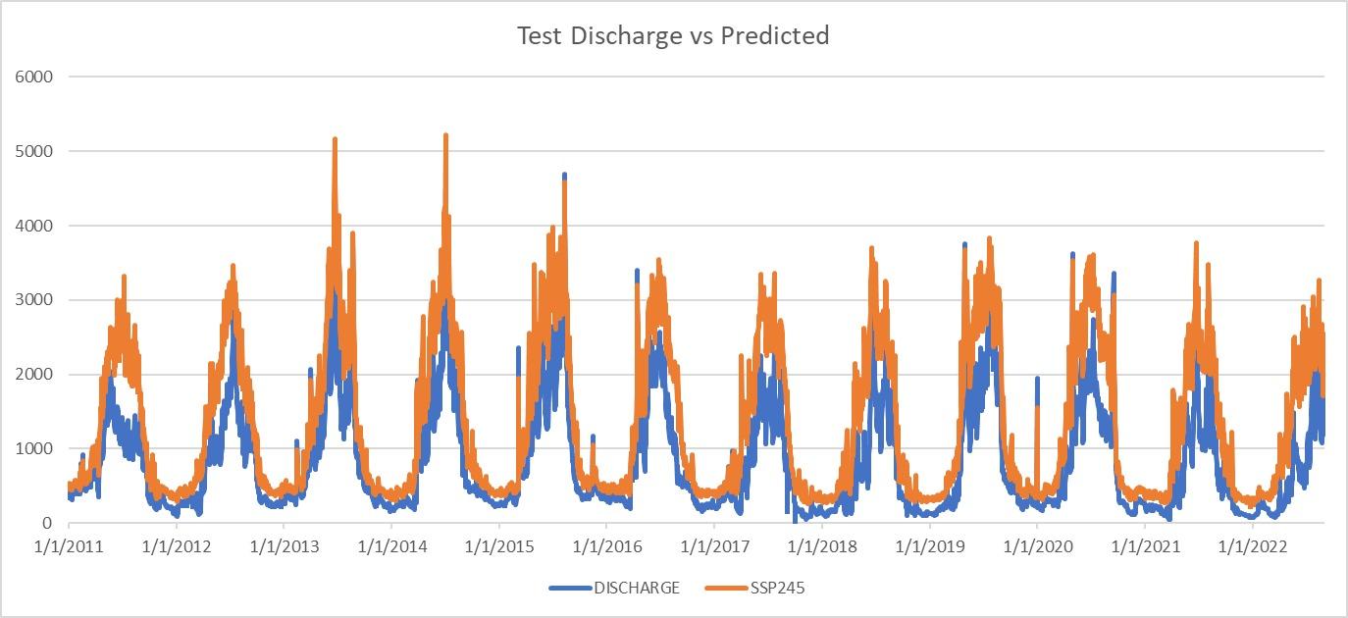
LSTM-CNN Test:

Slide 23
Worst Case Scenario SSP5-8.5:

Slide 24
Comparison of different Train/Test Splits for each model:
Model Name | 70:30 | 75:25 | 80:20
LSTM | 0.67 | 0.73 | 0.794
CNN | 0.761 | 0.84 | 0.813
LSTM-CNN | 0.87 | 0.91 | 0.84
Table: Different R^2 values in testing phase for different models under different split ratios for SSP5-8.5 scenario

Slide 25
Training Phase:

Slide 26
Model Name | R-squared | Observed RMSE(cumecs)
LSTM | 0.801 | 280.15
CNN | 0.83 | 254.86
LSTM-CNN | 0.89 | 232.93

Slide 27
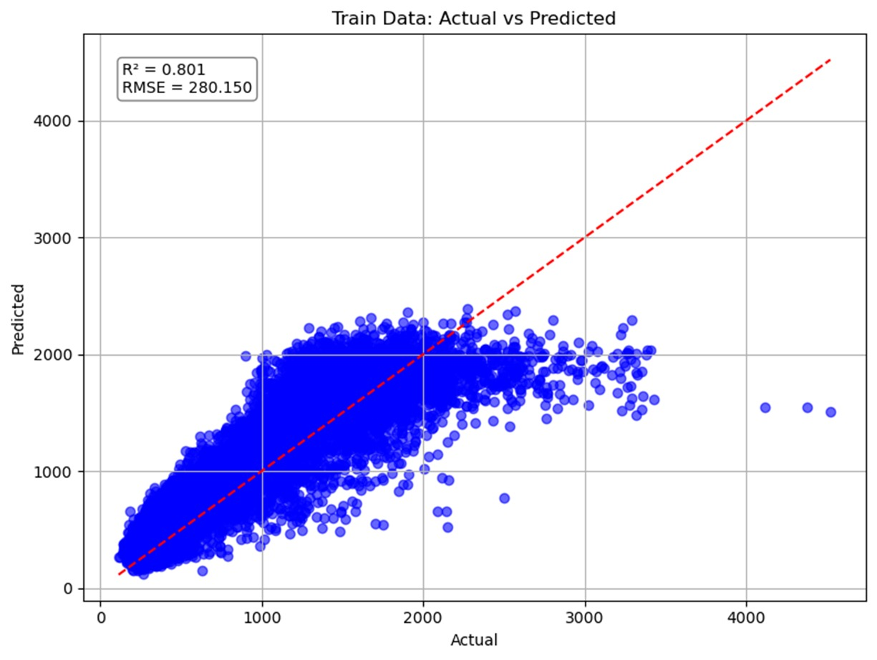
LSTM Train:
Predicted Discharge
Actual Discharge

Slide 28
LSTM Train:

Slide 29
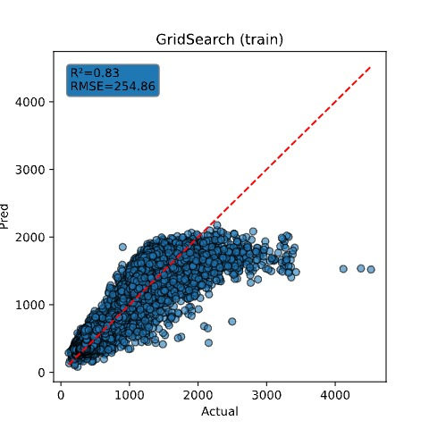
CNN Train:
Predicted Discharge
Actual Discharge

Slide 30
CNN Train:

Slide 31
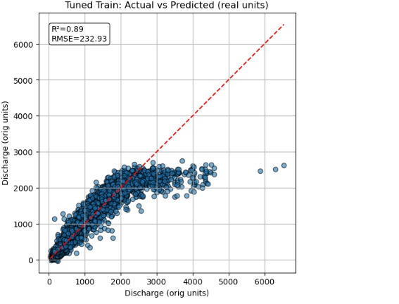
LSTM-CNN Train:
Predicted Discharge
Actual Discharge

Slide 32
LSTM-CNN Train:

Slide 33
Model Performance Indicators(Test Results):

Slide 34
Model Name | R-squared | Observed RMSE(cumecs)
LSTM | 0.794 | 281.567
CNN | 0.84 | 258.18
LSTM-CNN | 0.91 | 224.04

Slide 35
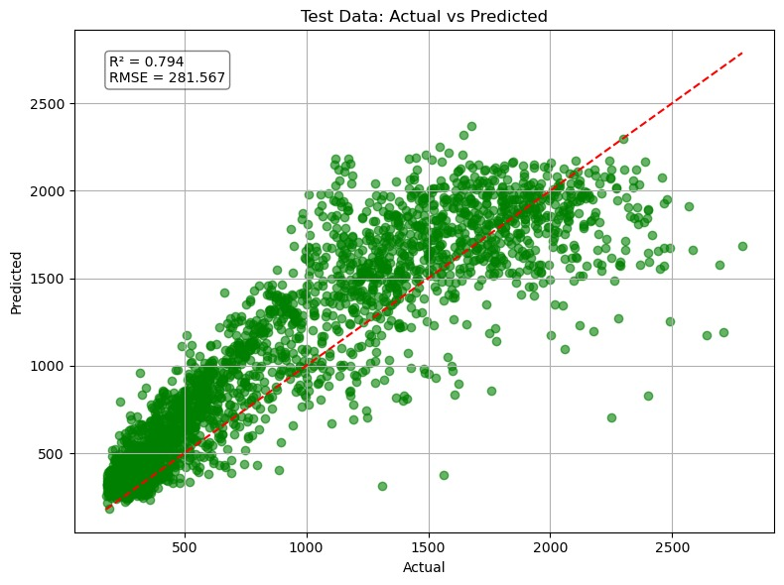
LSTM Test:
Predicted Discharge
Actual Discharge

Slide 36
LSTM Test:

Slide 37
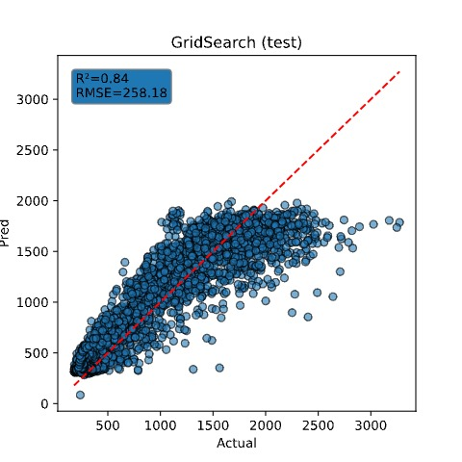
CNN Test:
Predicted Discharge
Actual Discharge

Slide 38
CNN Test:

Slide 39
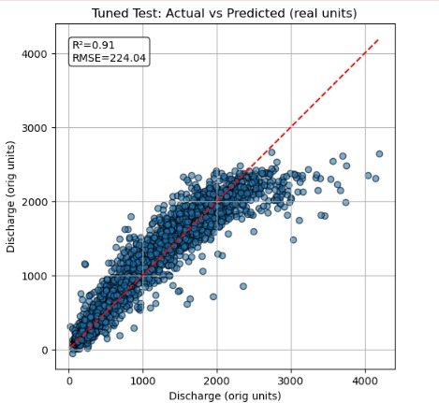
LSTM-CNN Test:
Predicted Value
Actual Discharge

Slide 40
LSTM-CNN Test:

Slide 41
Short Term Forecasting:

Slide 42
Short term forecasting:
Short Term forecasting was done for both scenarios i.e. SSP2-4.5 & SSP5-8.5 using all the three models whose results are discussed in the upcoming slides.
Models were trained on historical data and the discharge values for June 2022 were calculated and compared with the real values which were available .

Slide 43
Normal Case Scenario:

Slide 44
Model Name | R-squared | Observed RMSE(cumecs)
LSTM | 0.75 | 95
CNN | 0.85 | 66.5
LSTM-CNN | 0.89 | 50

Slide 45
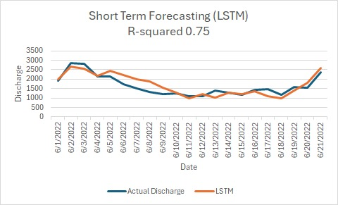
LSTM :

Slide 46
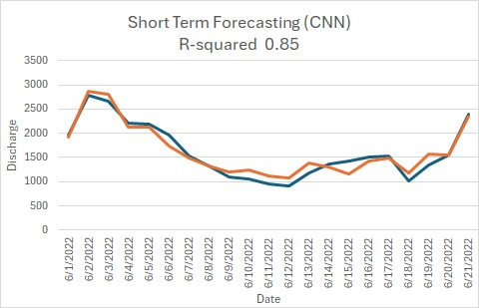
CNN :

Slide 47
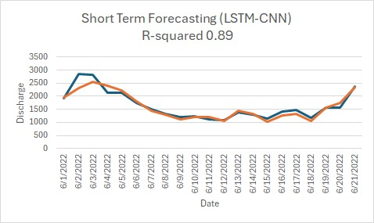
LSTM-CNN :

Slide 48
Worst Case Scenario:

Slide 49
Model Name | R-squared | Observed RMSE(cumecs)
LSTM | 0.702 | 117
CNN | 0.8154 | 78
LSTM-CNN | 0.887 | 58

Slide 50
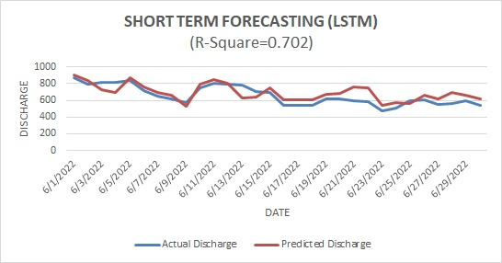
LSTM :

Slide 51
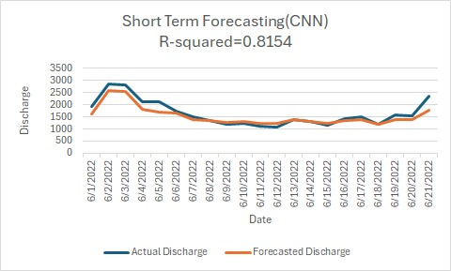
CNN :

Slide 52
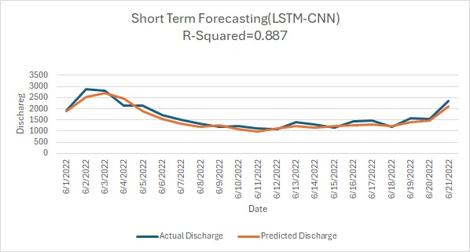
LSTM-CNN :

Slide 53
Long Term Forecasting:

Slide 54
Long term forecasting:
Long Term forecasting was done for both scenarios i.e. SSP2-4.5 & SSP5-8.5 using the best performing model (LSTM-CNN) whose results are discussed in the upcoming slides.
Model was trained on historical data and the discharge values for near future (2041-2060), middle future (2061-2080) & far future (2081-2100) were plotted.

Slide 55
Normal Case Scenario:

Slide 56
SSP2-4.5:
SSP2-4.5
Future Periods | Lowest discharge | Highest | Range
Near (2041-2060) | 684.71 cumecs | 2234.53 cumecs | 1549.82
Middle (2061-2080) | 737.38 cumecs | 2291.67 cumecs | 1554.05
Far (2081-2100) | 790.04 | 2450.86 | 1660.81
Hybrid Model predicted discharge under SSP2-4.5 scenario

Slide 57
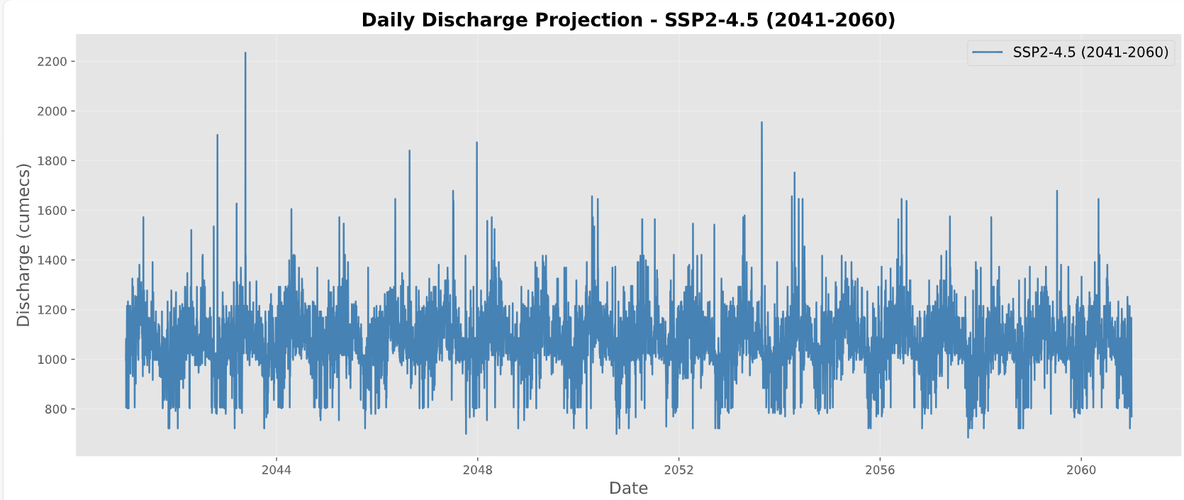
Near Future:(2041-2060)
Predicted discharge value for near future under SSP2-4.5 scenario

Slide 58
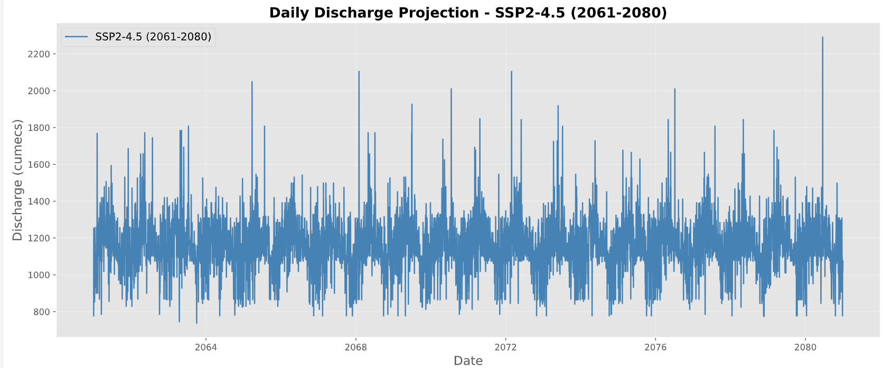
Middle Future:(2061-2080)
Predicted discharge value for middle future under SSP2-4.5 scenario

Slide 59
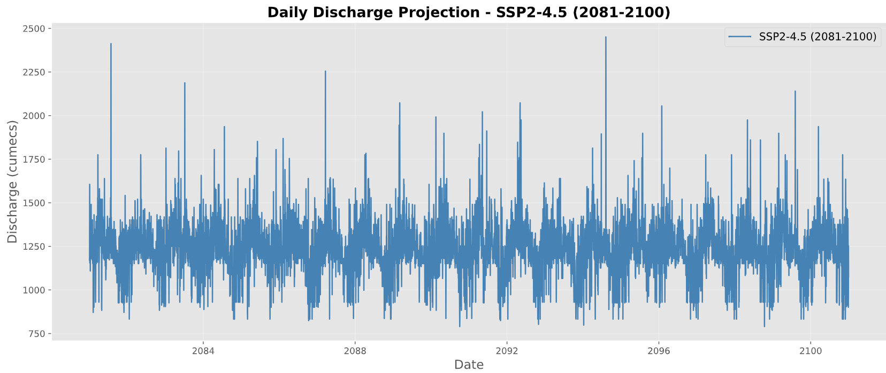
far Future:(2081-2100)
Predicted discharge value for far future under SSP2-4.5 scenario

Slide 60
Worst Case Scenario:

Slide 61
SSP5-8.5:
SSP5-8.5
Future Periods | Lowest discharge | Highest | Range
Near (2041-2060) | 1975.14 cumecs | 6445.67 cumecs | 4470.53
Middle (2061-2080) | 2238.49 cumecs | 6956.14 cumecs | 4717.66
Far (2081-2100) | 2501.84 cumecs | 7761.07 cumecs | 5259.23
Different Model Performance under SSP5-8.5 scenario

Slide 62
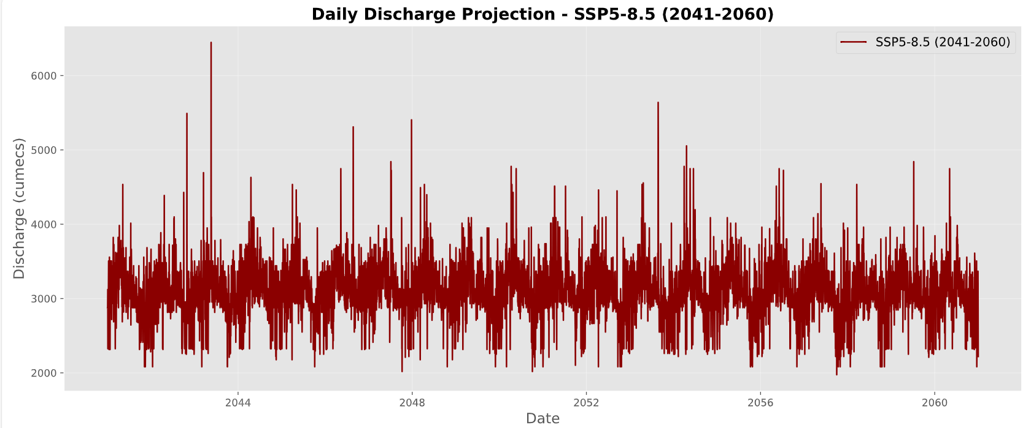
near Future:(2041-2060)
Predicted discharge value for near future under SSP5-8.5 scenario

Slide 63
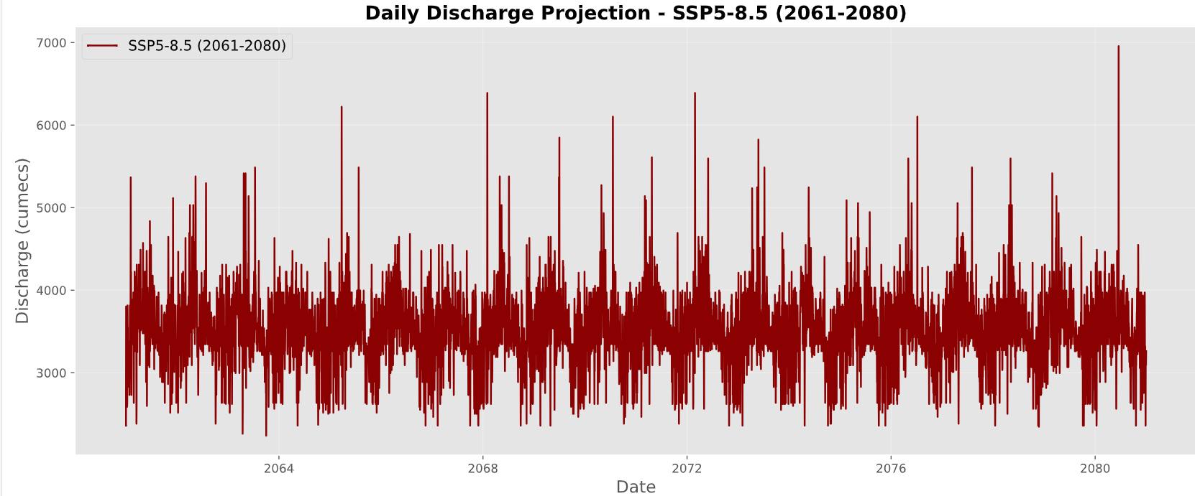
middle Future:(2061-2080)
Predicted discharge value for middle future under SSP5-8.5 scenario

Slide 64
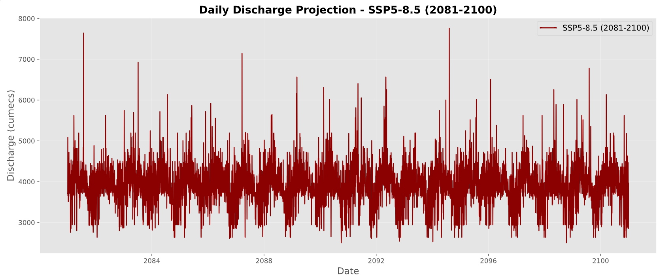
far Future:(2081-2100)
Predicted discharge value for far future under SSP5-8.5 scenario

Slide 65
Results:
Hybrid Model Performance:
The hybrid CNN-LSTM model outperformed both CNN and LSTM in short-term and long-term forecasting, maintaining strong predictive power.
Impact of SSP5-8.5:
Under SSP5-8.5, discharge projections showed significant increases (20% for the highest, 27% for the lowest), indicating more extreme flood events.
Short-Term Forecasting:
The hybrid model provided reasonably accurate short-term forecasts with low RMSE, ideal for flood forecasting.
Long-Term Forecasting Trends:
SSP2-4.5 showed more gradual discharge increases, with a
10% rise in the highest and 15% in the lowest, stressing the need for proactive flood risk management.

Slide 66
Conclusions:
Model Effectiveness:
Hybrid CNN-LSTM outperformed LSTM and CNN in all scenarios, with the highest R² and lowest RMSE, especially in short-term forecasting.
Adaptability to Emission Scenarios:
The hybrid model showed the best adaptability to the high-emission SSP5-8.5 scenario, indicating robustness in extreme climate conditions.
Implications for Long-Term Projections:
Long-term discharge projections highlight significant increases in flood magnitude under higher-emission scenarios, valuable for water resource planning.
Future Work:
Further optimizations and real-time forecasting integration could improve model accuracy and practical application in flood management.

Slide 67
References:
Novel Hybrid Evolutionary Algorithms for Spatial Prediction of Floods, Novel Hybrid Evolutionary Algorithms for Spatial Prediction of Floods | Scientific Reports
Pakistan Floods 2022: Post-Disaster Needs Assessment (PDNA) | United Nations Development Programme
Flood Prediction Using Machine Learning Models: Literature Review, Flood Prediction Using Machine Learning Models: Literature Review
Metrics Assessment and Streamflow Modeling under Changing Climate in a Data-Scarce Heterogeneous Region: A Case Study of the Kabul River Basin, : Metrics Assessment and Streamflow Modeling under Changing Climate in a Data-Scarce Heterogeneous Region: A Case Study of the Kabul River Basin.
Exploring climate change impacts during the first half of the 21st century on flow regime of the transboundary Kabul River in the Hindukush region,: (PDF) Exploring climate change impacts during the first half of the 21st century on flow regime of the transboundary Kabul River in the Hindukush region

Slide 68

Thank you!

